Slide 1
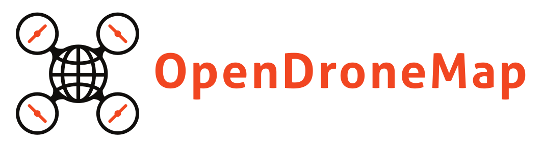
Dakota Benjamin, Geospatial Developer, Cleveland Metroparks
@dakotabenjammin
Stephen Mather, GIS Manager, Cleveland Metroparks
@smathermather

Slide 2
OpenDroneMap is an open source toolkit for aerial drone imagery.
It is modern photogrammetry - fully automated matching, digital surface modelling, and mosaicking

Slide 3
Presentation Layout
Practical overview
Anatomical breakdown
Future Plans

Slide 4
Origins
Computer Vision
Stereo views of the world
Notes:
OpenDroneMap originates from Computer Vision, i.e. how do we enable computers to navigate and understand the world.
It depends on stereo vision much like we do to make sense of the world in 3D

Slide 5
Photogrammetry Process
Structure from Motion
Point Cloud Densification
Poisson Surface Reconstruction
Multi-View Stereo Texturing
Orthophoto Generation

Slide 6
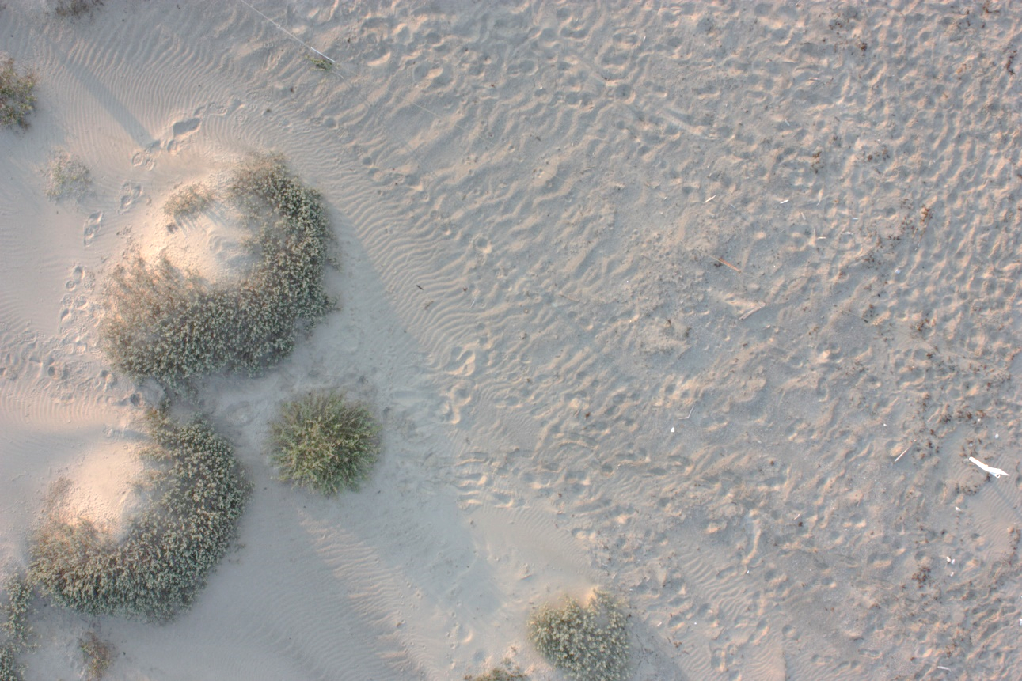
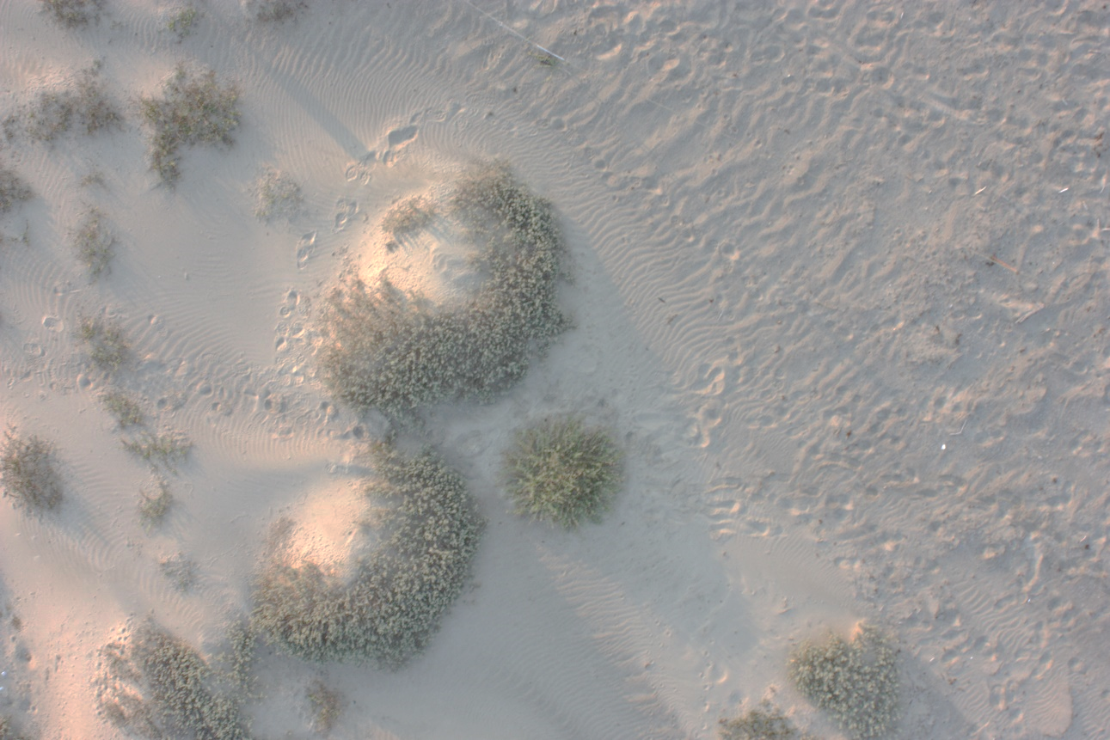
Structure from Motion
Matches features extracted from images with overlap
Credit: Michelle Tobias

Slide 7
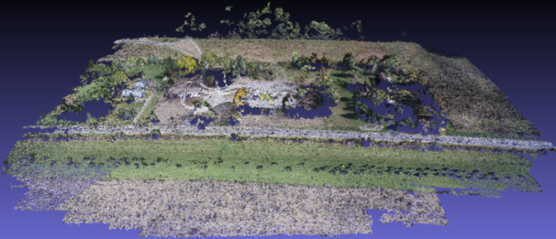
Point Cloud from Matching
Notes:
(Photogrammetrically Derived Point Cloud)

Slide 8
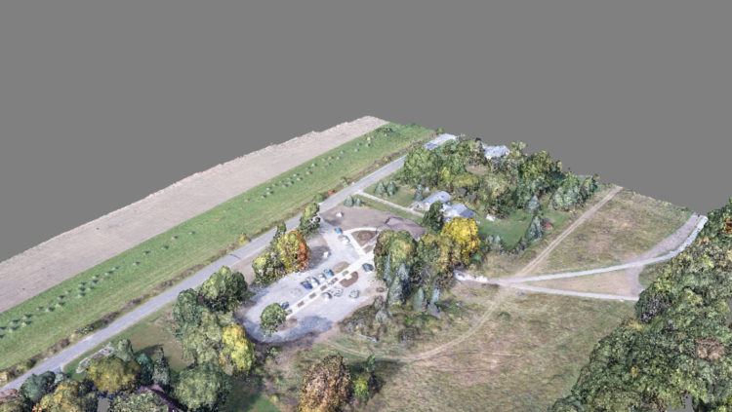
Dense Point Cloud from finding all matches

Slide 9
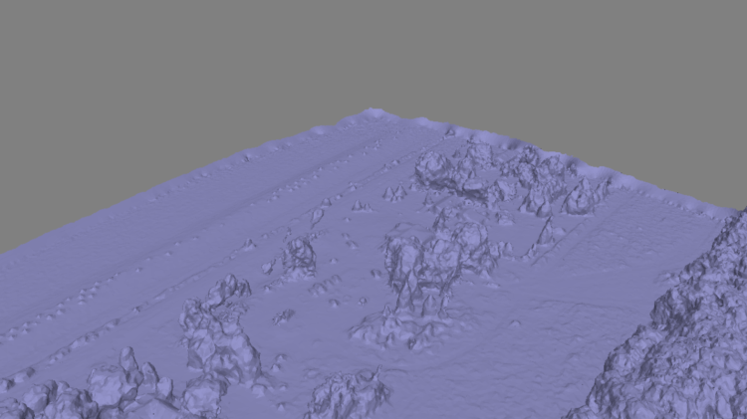
Mesh
Notes:
Uses the Point Cloud Library (PCL), followed by mesh decimation

Slide 10
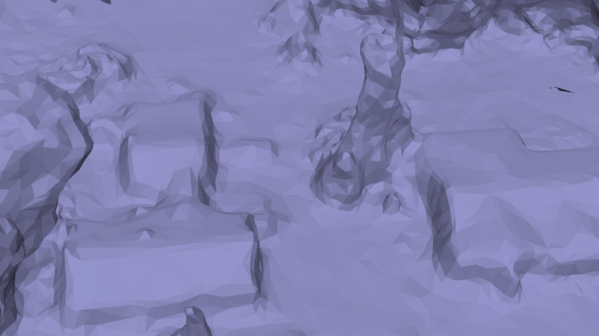
Mesh
Notes:
Uses the Point Cloud Library (PCL), followed by mesh decimation

Slide 11
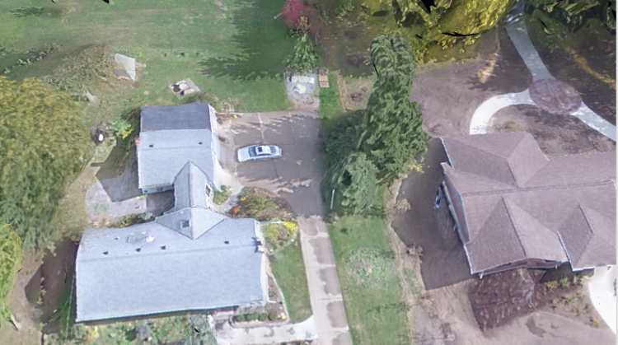
Texturing

Slide 12
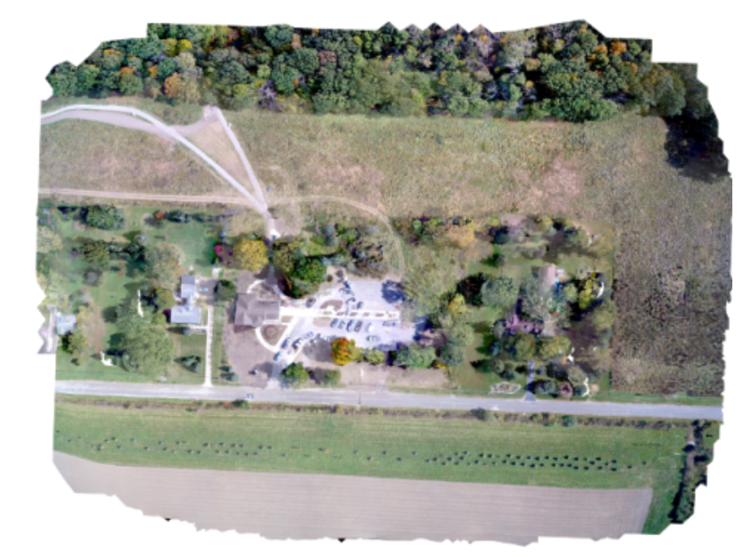
Orthophoto Generation

Slide 13
Installation
There are many ways to install ODM:
Natively using Ubuntu 14.04 or later (or with Virtual Machine via vagrant)
MacOS or Windows, by installing Docker (not covered today)
With a Web-based GUI called WebODM (functional, but limited and currently in heavy development)

Slide 14
Installation and Usage
Download:
V0.2 Release: https://github.com/OpenDroneMap/OpenDroneMap/releases/download/v0.2/OpenDroneMap-v0_2.zip
Latest Development: (git)
git clone https://github.com/OpenDroneMap/OpenDroneMap.git
Or download link above (sans “.git”)
Install
$ ./configure.sh

Slide 15
Installation (cont.)
3. Set environment variables
Open “~/.bashrc in your favorite editor and append:
export PYTHONPATH=$PYTHONPATH:/your/path/OpenDroneMap/SuperBuild/install/lib/python2.7/dist-packages
export PYTHONPATH=$PYTHONPATH:/your/path/OpenDroneMap/SuperBuild/src/opensfm
export LD_LIBRARY_PATH=$LD_LIBRARY_PATH:/your/path/OpenDroneMap/SuperBuild/install/lib
Replace “/your/path/” appropriately
Log out/in again

Slide 16
Running OpenDroneMap
Project Setup:
Create a project folder and places your images in an "images" directory:
|-- /path/to/project/
|-- images/
|-- img-1234.jpg
|-- ...
Then run:
python run.py -–project-path /path/to/project

Slide 17
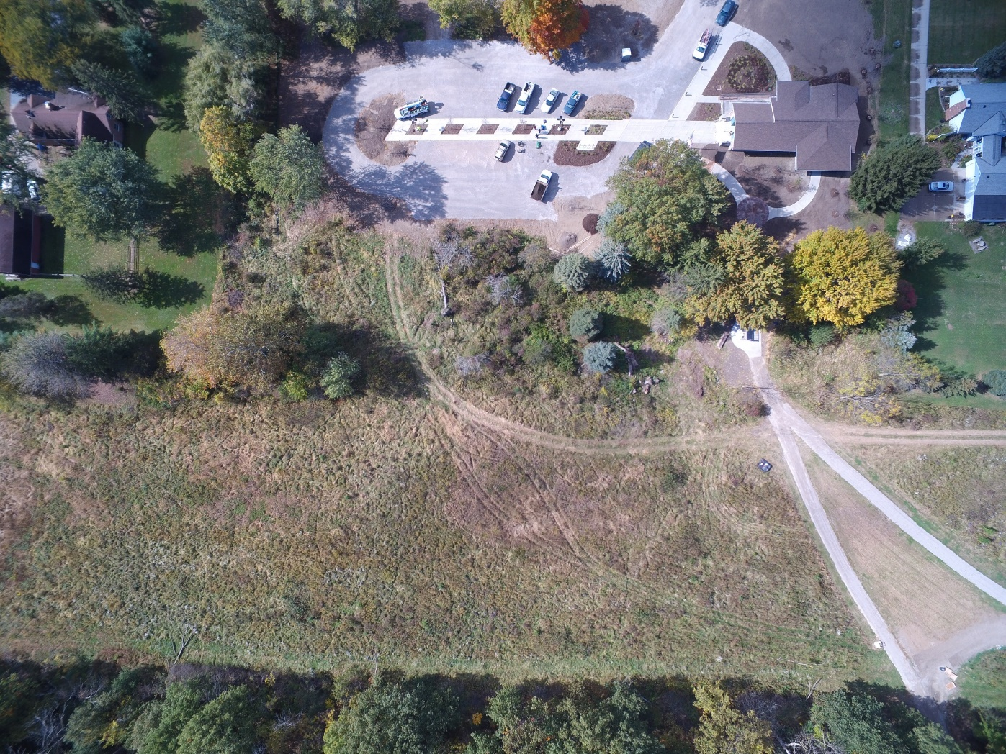
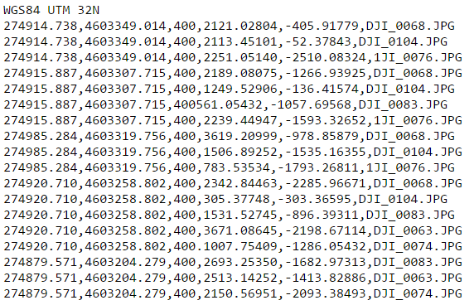
Inputs / Outputs

Slide 18
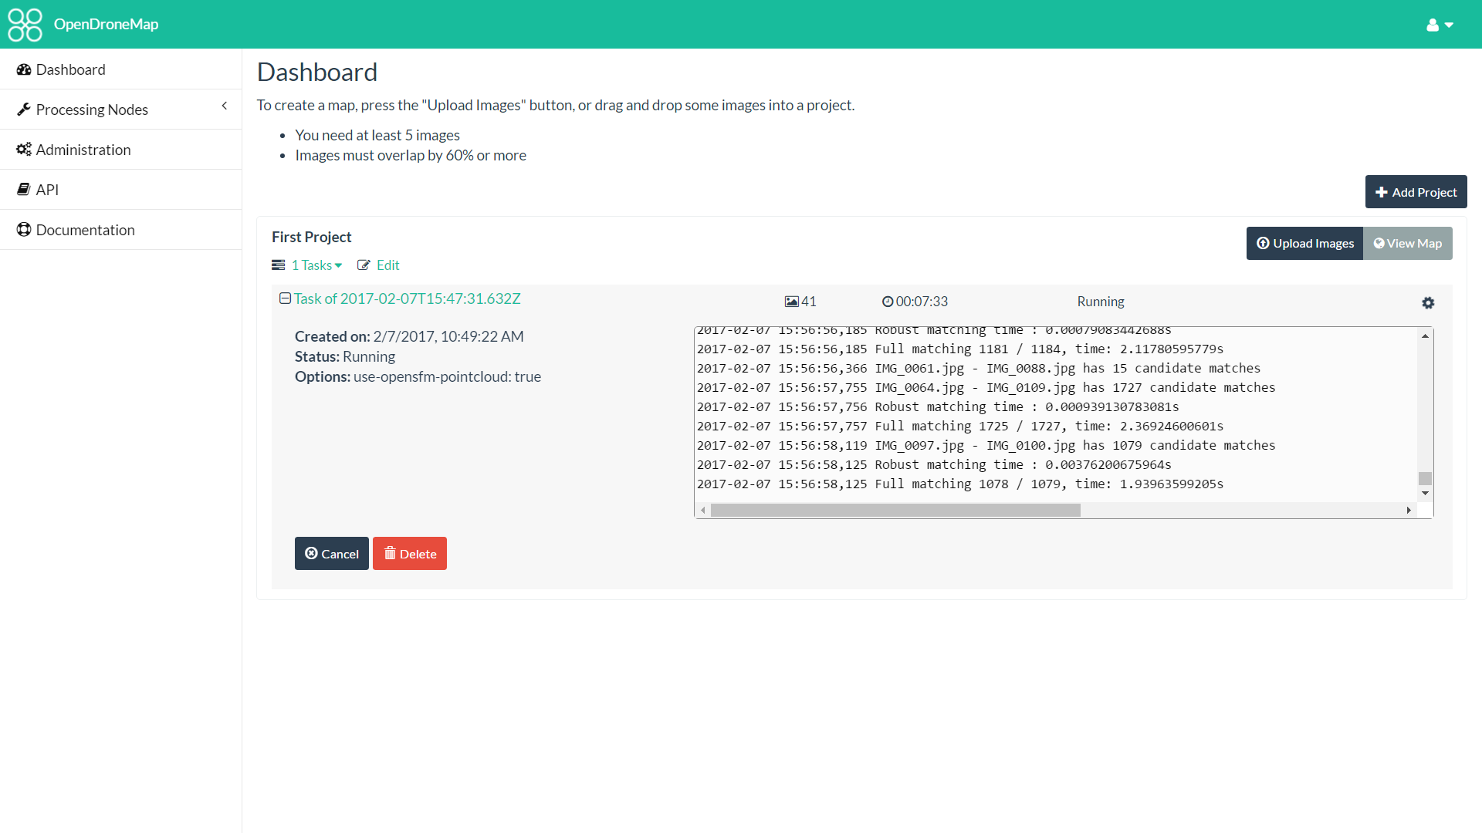

Slide 19
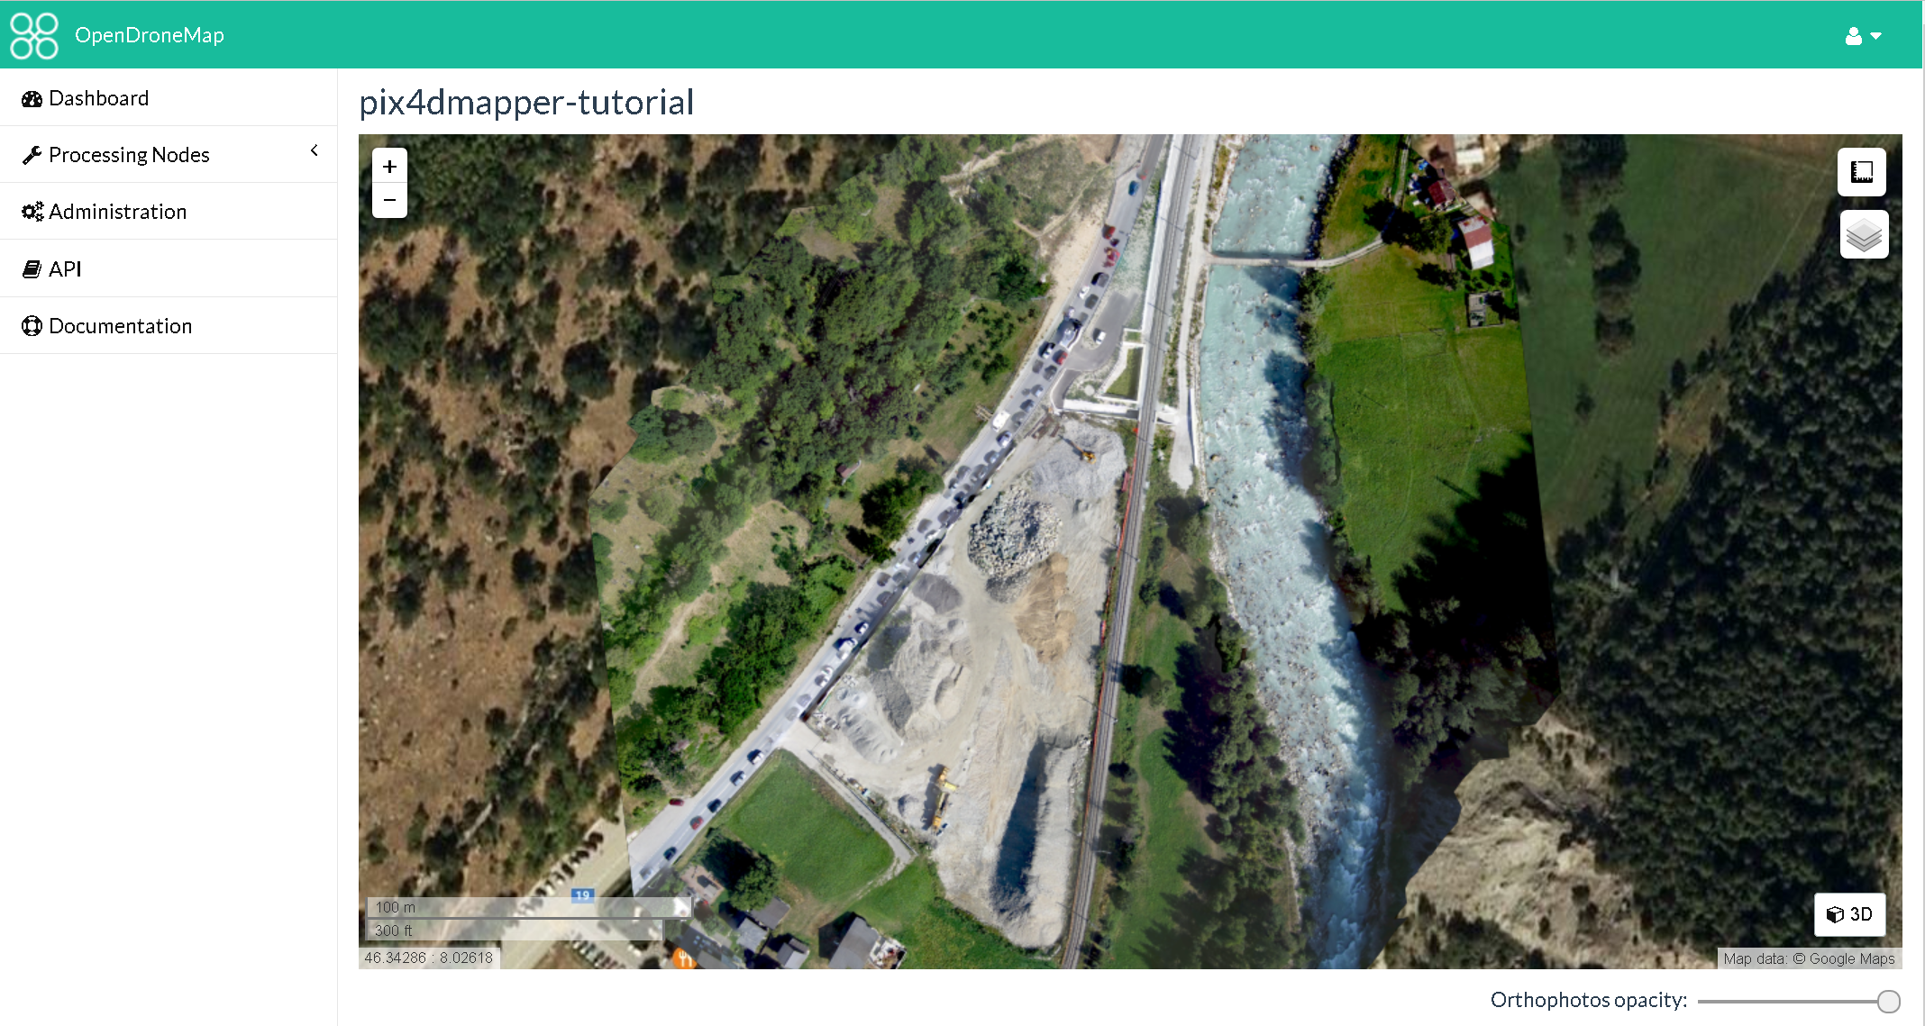

Slide 20
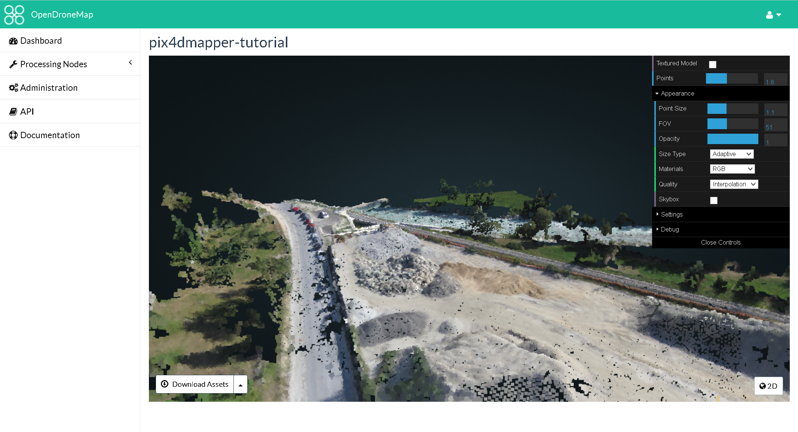

Slide 21
OpenDroneMap: Future
Scalability
Reduce memory footprint
Data Partitioning
Analysis
Add automated DEM extraction
Classification
Mesh improvements
Testing

Slide 22
WebODM: Future
DEM display
Volumetric Measurements
Mission Planning
Mobile App for autonomous flight
QGIS integration

